Slide 1
Data Science Corp
Understanding Health & Wellness of Young Adults
Group 1
BUAN 6337.501

Slide 2
Proposed Analysis
Study the lifestyle of young adults and their eating habits:
Stress is high among young adults
There is a correlation between stress and their eating habits, such as eating out often at fast food restaurants and snacking
Consumer centric approach
As “Data Science Corp” we would like to study the market for a healthier food option for one of SRG’s client, F&B. For this we want to analyze user preferences and design marketing strategies accordingly. We need to do the following analysis to understand our market better.

Slide 3
Responses that drew our attention...
“I often wish I had more energy” - Q1rp
“I am so busy, I often can't finish everything I need to in a day” - Q1rq
“Stress keeps me from being the type of person I really want to be” - Q1ra
Is there a correlation between Age and Stress? What age groups are more stressed?

Slide 4
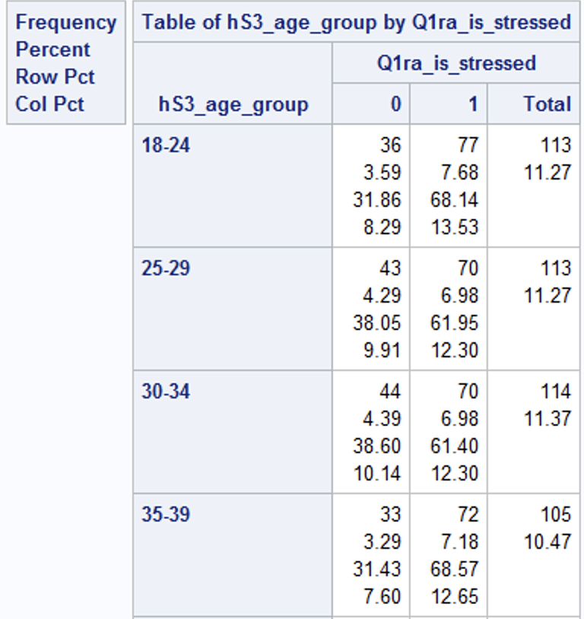
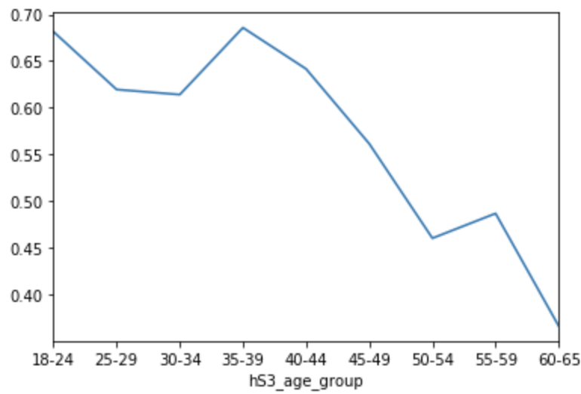
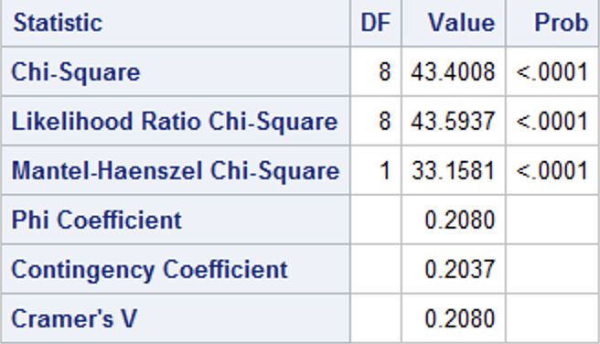
Hypothesis 1: People in younger age groups are more stressed than others
There is strong correlation between age-group and stress. As we can see age-group 18-24 and 35-39 have the highest percentages of stressed people in them (68.14 and 68.57 respectively).

Slide 5
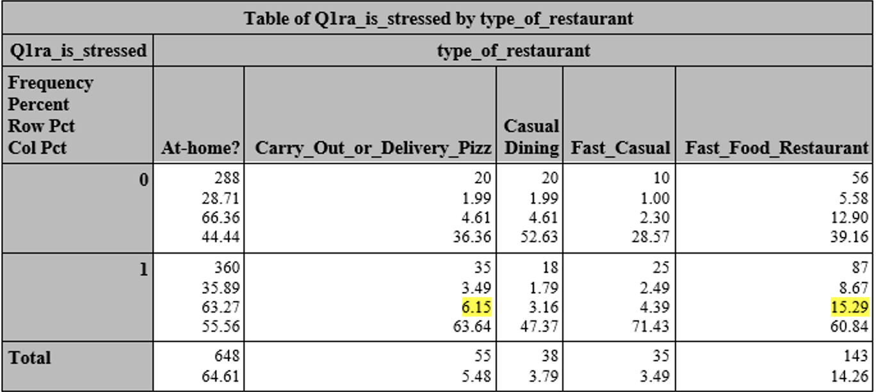
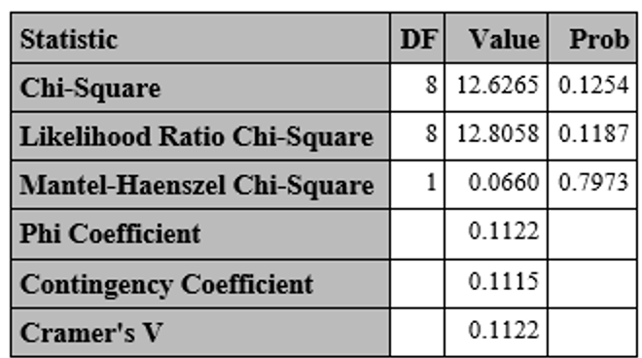
Hypothesis 2: Those who are stressed have different eating habits than others
Crosstab analysis shows that people who are stressed usually eat out more than others, also they prefer carryout pizza and fast food more than others.

Slide 6
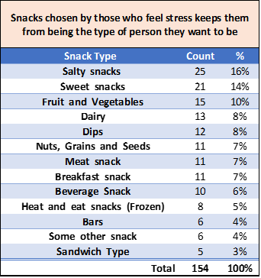
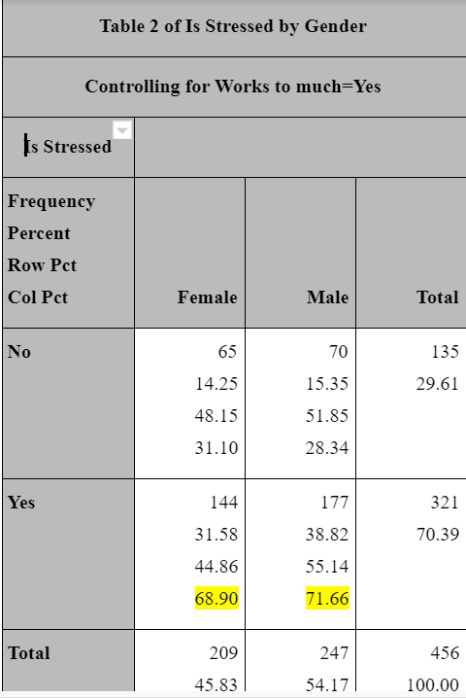
Hypothesis 3: People with busy working schedules and a high level of stress skip dinner/ snack at night
68.9% of females and 71.7% of males who said to have worked too much also felt stressed.

Slide 7
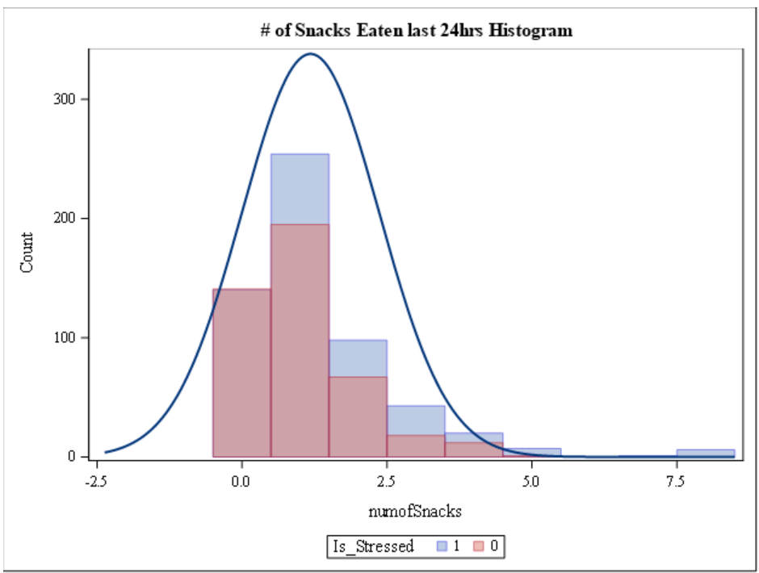
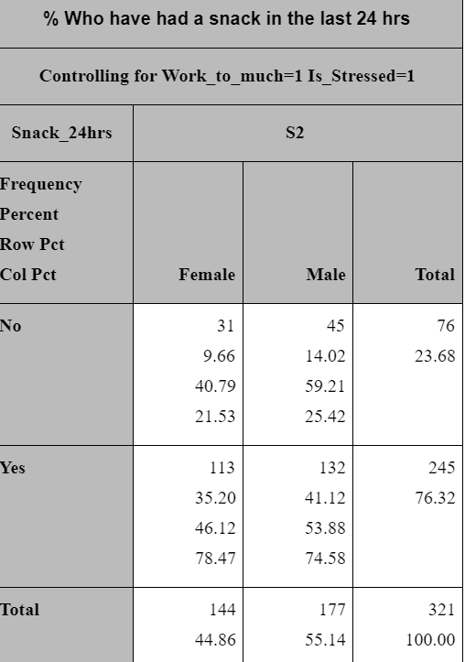
People who feel they are stressed also have some sort of eating disorder- either eating out too much or snacking more than regular- We suggest healthier snack and dinner options. But what food options are popular in demand right now?

Slide 8
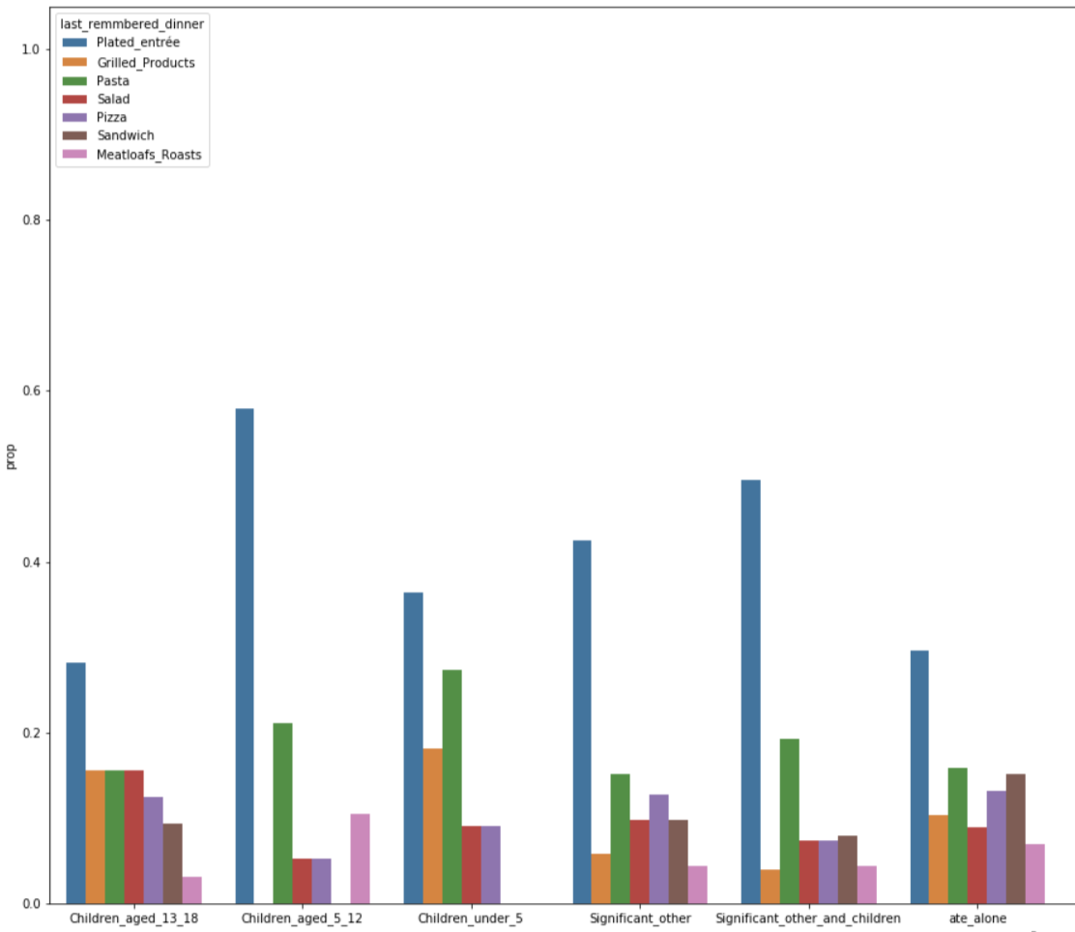
What do people prefer right now?

Slide 9
Analysis of Graph
People in general prefer a Plated entree, which is usually a balanced meal of protein and carbohydrates (Rice with chicken, Chicken with vegetables/potatoes etc.)
We can see that Plated entree (balanced meal) consists of up to 42% of meals in family dinners (people who dined with children aged 5-12), while it’s only 19% in case of people who ate alone. On the other hand, people who eat alone, their dinner choices include more variety than people who do not eat alone.

Slide 10
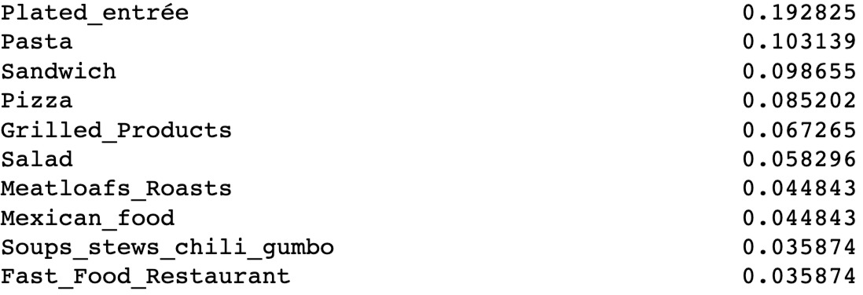
Top Dinner Choices for People Who Eat Alone
Plated Entree
Pasta
Sandwich

Slide 11
People who eat alone
Tend to be more depressed rather than those who eat with family, friends or a colleague. And while people who ate with others probably did not have complete freedom to make their dinner choices (or influenced by others), the people who ate alone are the people who made their own dinner choices, meaning they have more freedom to choose their dinner.
This is beneficial for us due to two reasons. First, we will get a very accurate estimate of the person’s preference. A person buying pizza for himself as opposed to a spouse choosing a restaurant to eat.
Secondly, because this group has more freedom to buy for themselves, they make a good target group for marketing experiments.

Slide 12
Our Products
Dinner Product 1: Archer Farms (Premium Brand) Multigrain Sandwich 200 calories $4.00 (Healthy Sandwich)
Dinner Product 2: Great Value (Walmart Brand) Totino’s triple meat Pizza 250 calories $2.50 (Tasty Pizza)
Snack Product 1: Welch's Fat & Gluten free Mixed Fruit Snacks 80 calories/serving $3.99
Snack Product 2: Tostitos Scoops! Tortilla Chips, Party Size 140 calories/serving $2.98

Slide 13
Hypothesis 4: What factors influence intention of buying Product 1 and Product 2 among stressed people?
Model Intention of customer based on the following factors:
Price, Store Brand, Taste, Quality, Natural Product and Calories
When it comes to food, I’m primarily a price shopper (Price) Q30rbb_food_price_shopper
I prefer to buy store brands (store brand) Q30ram
I eat for taste enjoyment more than for health purposes (Preference to taste) Q30rbm
I buy based on quality, not price (Quality) Q30rbc
I go out of my way to buy products that are all natural (Natural Product) Q30rae
I don’t allow junk food in my home (Calorie) Q30rao
If the user answered Questions 1,2,3 as agreed/strongly agreed , then he has shown intention to buy product 1 (choice =1)
If the user has answered Questions 4,5,6 as agreed/strongly agreed , then he has shown intention to buy product 2 (choice =2)
If the user answered similarly for both question sets, then Unsure (choice = 3)

Slide 14
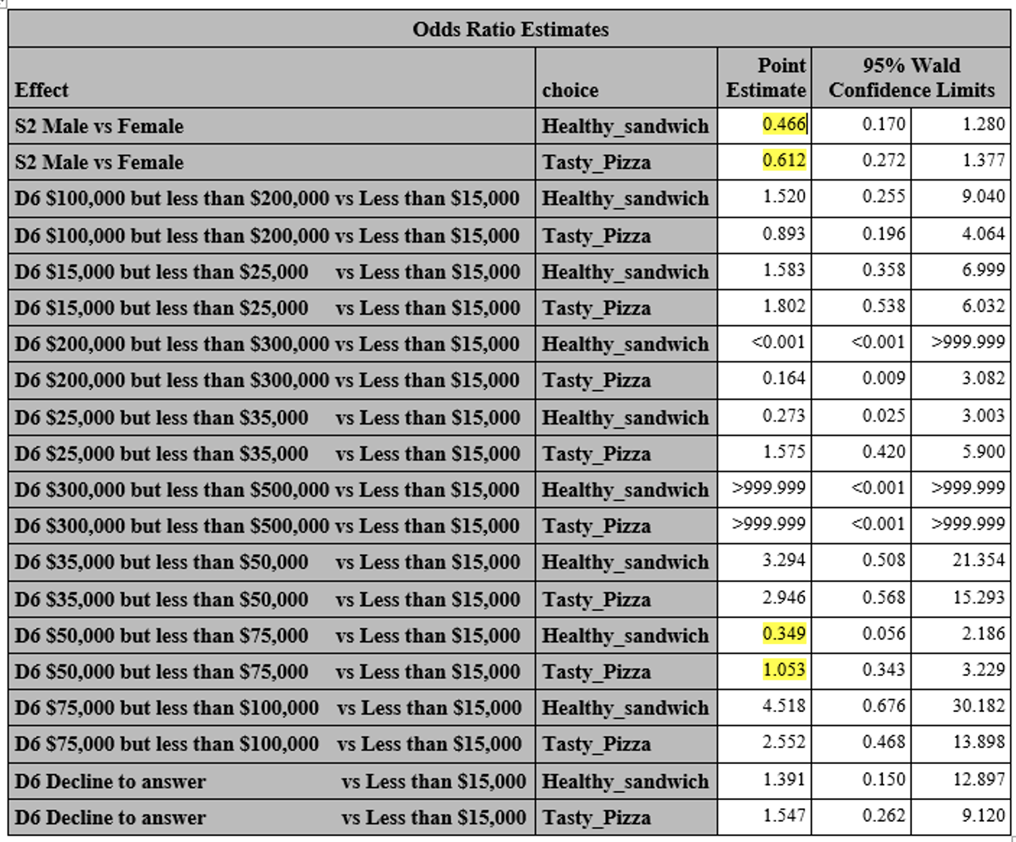
Logistics Model
Choice = Gender + income_group + age + is_stressed + is_stressed*age

Slide 15
Analysis of Model Results
People who earn between 50K-75K are more likely to buy Tasty Pizza (Odds ratio = 1.053) compared to People who earn less than 15K
On the other hand, people who earn between 75K and 100K are more likely to buy a healthy sandwich (Odds Ratio of 1.96 = 4.518 - 2.552 ) compared to the tasty Pizza.
Men are less likely to buy either a Healthy sandwich or tasty Pizza compared to women and with increase in age the log odds ratio of Tasty Pizza is higher than Healthy Sandwich.
Among all the people who eat alone and are stressed, the log odds ratio of intention to buy a “Tasty Pizza” will be higher among people who earn between 75K-100K and lower among people who earn between 200K-300K.
So our target group is young females who earn between 75K-100K, this is the group that has shown more intention to buy a healthy sandwich (Quality, less preference to price) and therefore prime target customers for F&B. For other customers who are still keen on having tasty pizza, F&B should introduce a healthier but tastier pizza option that is also cheap.

Slide 16
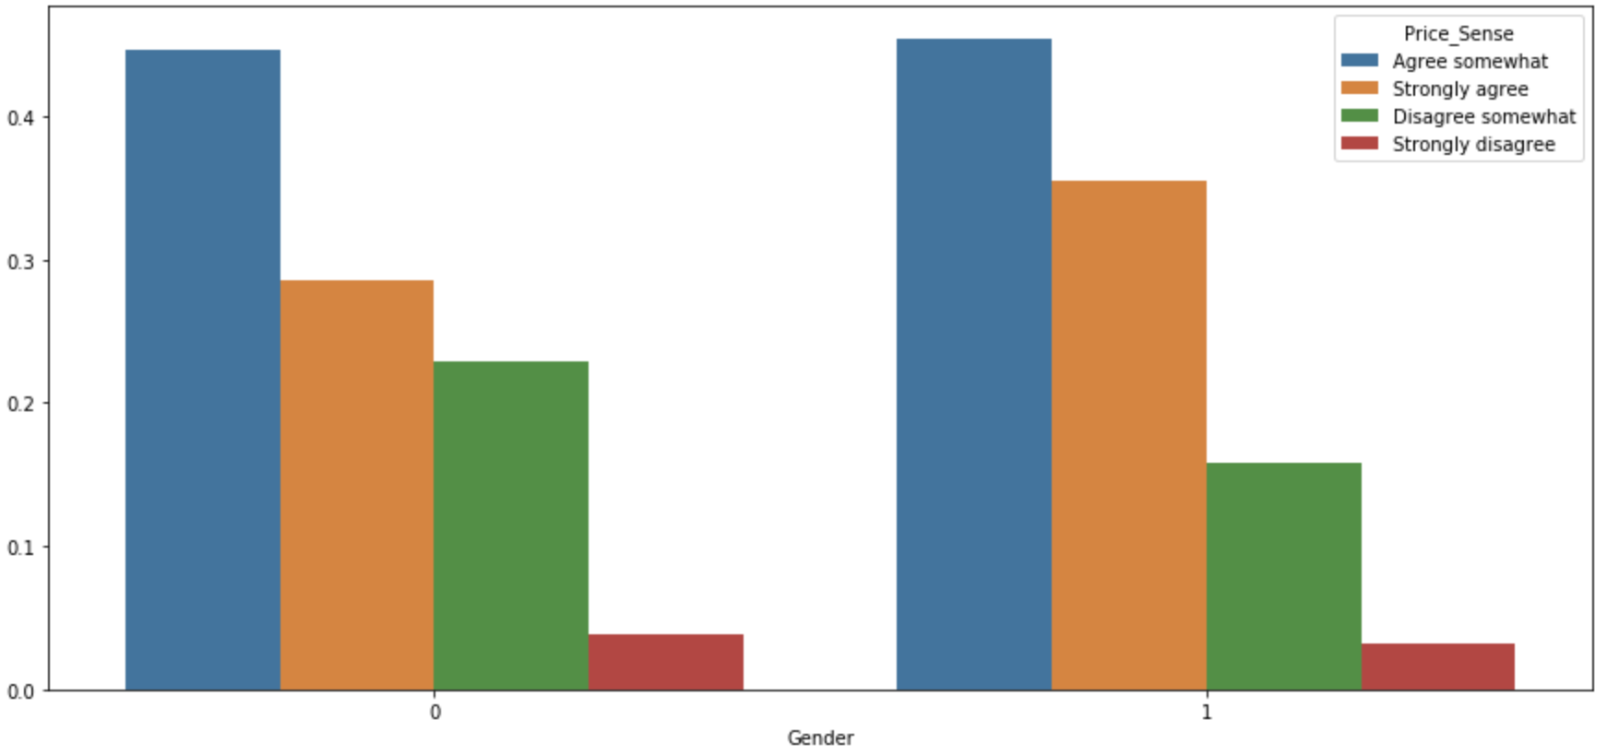
Price Sensitivity Between Genders
More females (1) believe they agree to shopping based on price (Orange bar), while males (0) there are more who disagree with buying on price. So, women in general are more price sensitive.

Slide 17
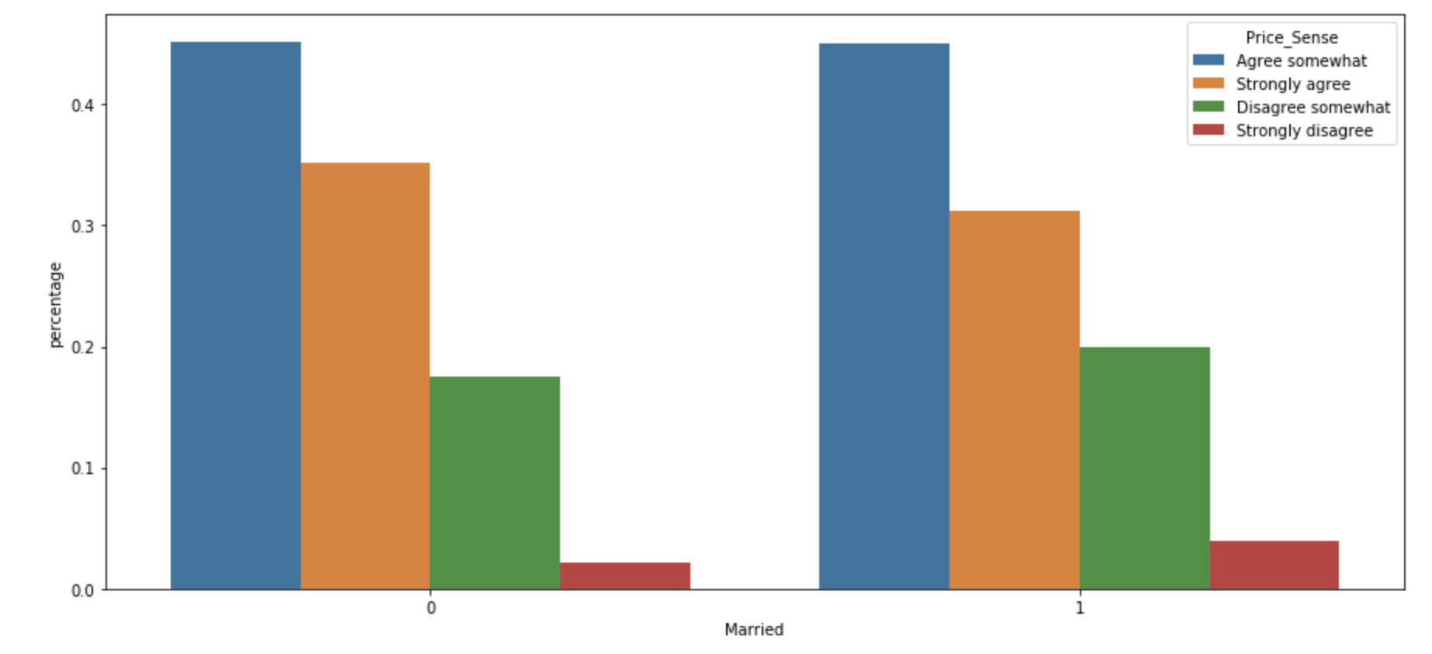
Price Sensitivity Among Married and Single People
People who are married/living with their partner (1) seem to be less price sensitive compared to single people, though the difference does not seem to be significant.

Slide 18
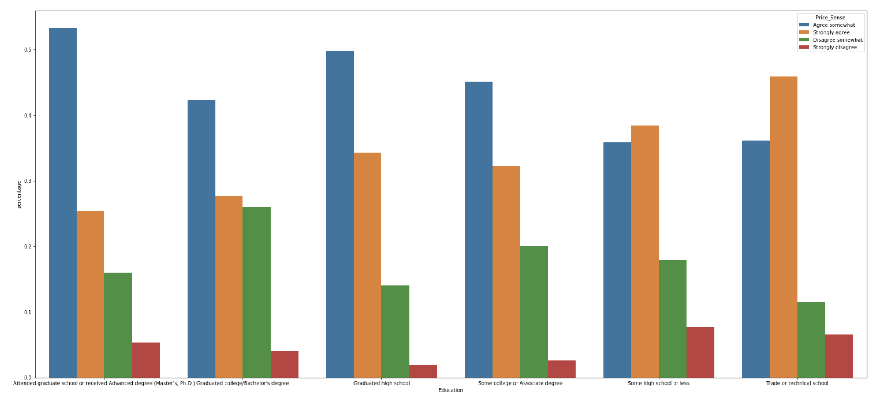
Price Sensitivity Among Different Educational Backgrounds
People with bachelor's or more advanced degrees seem to be less price sensitive compared to others, which is expected as they are more likely to have a higher income.

Slide 19
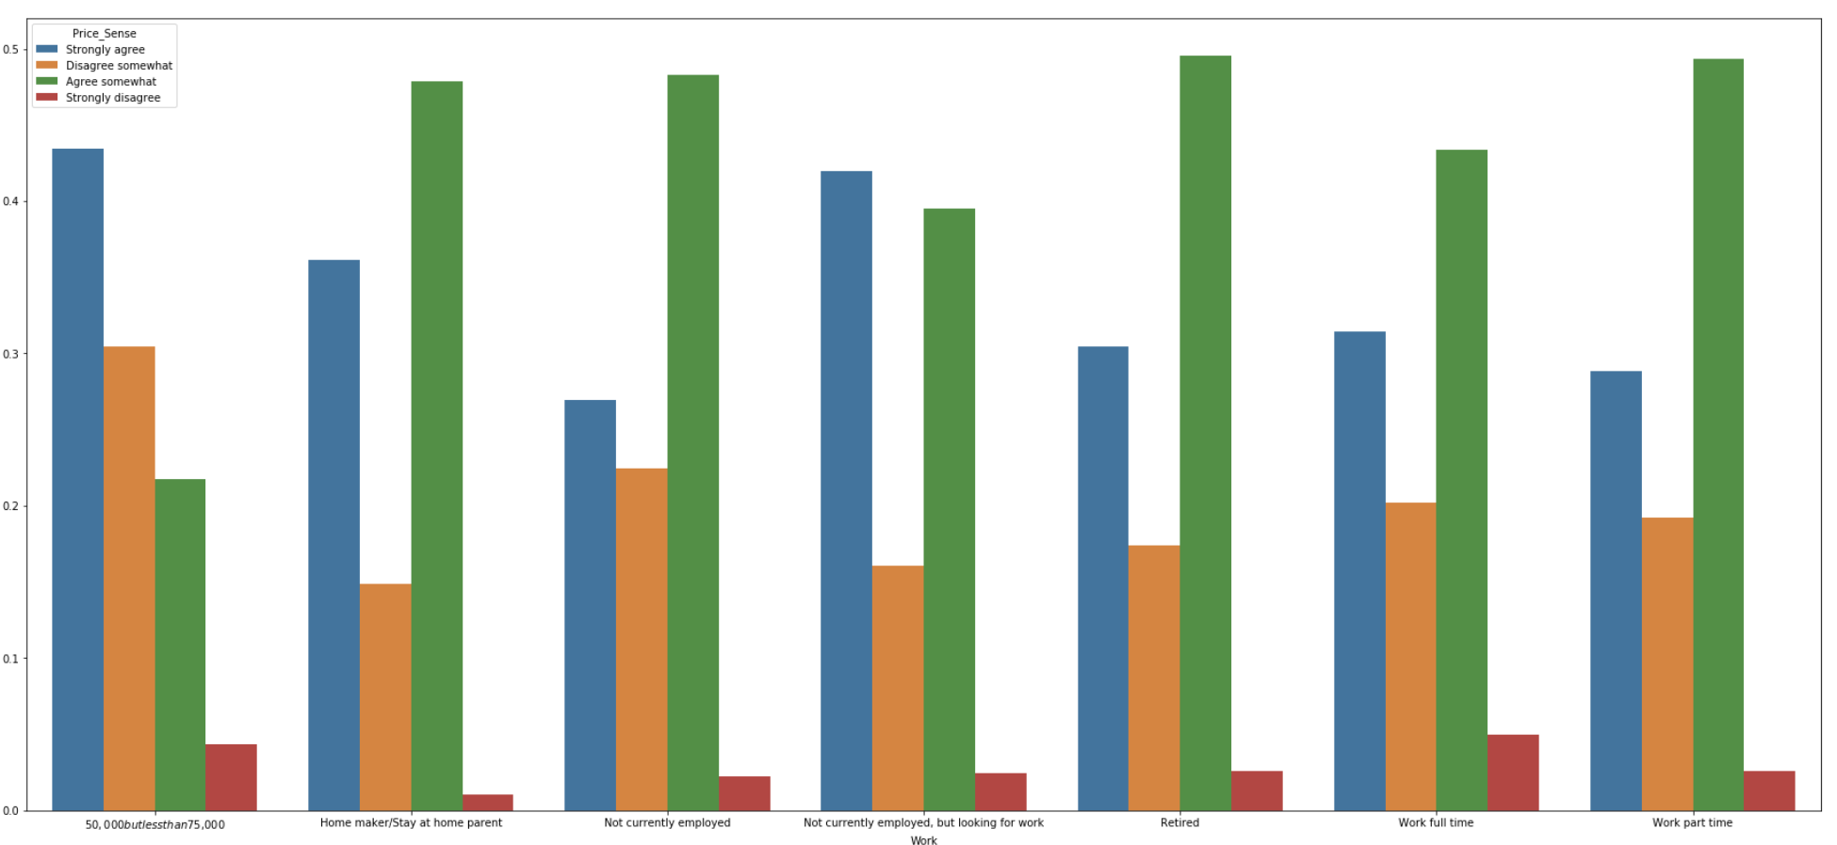
Price Sensitivity Among Employed and Unemployed
As expected unemployed people are more price sensitive than people who are currently employed.

Slide 20
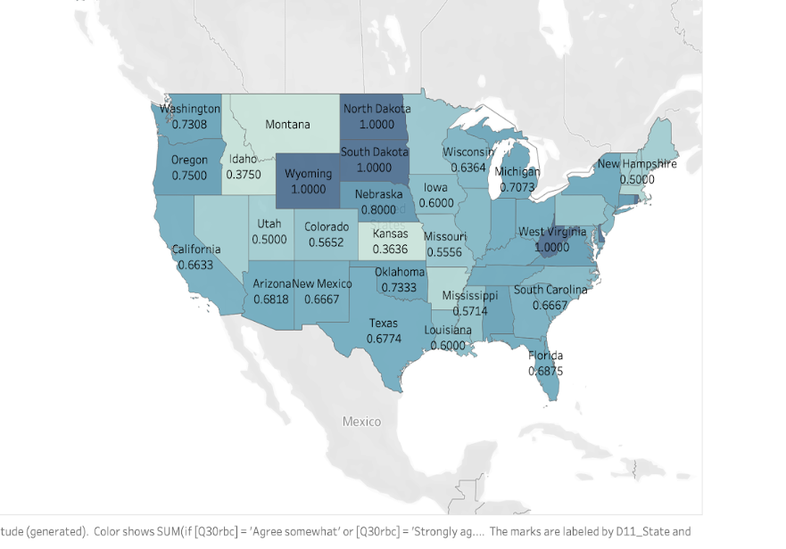
Price sensitivity Among States in the U.S
We can see in most states about 70-80% buy based on quality not price, the exceptions are Pennsylvania, Colorado, Missouri where about 55-60% people buy on quality. Which means our pricing of the product should be different in these states.

Slide 21
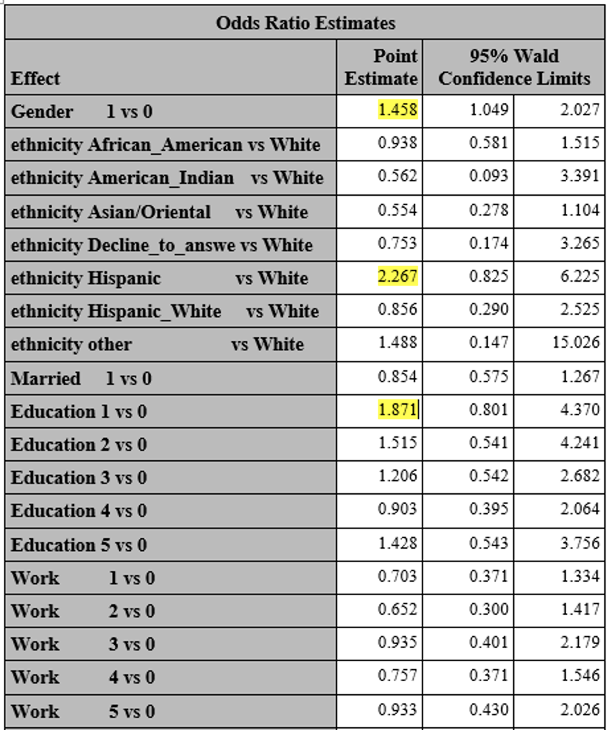
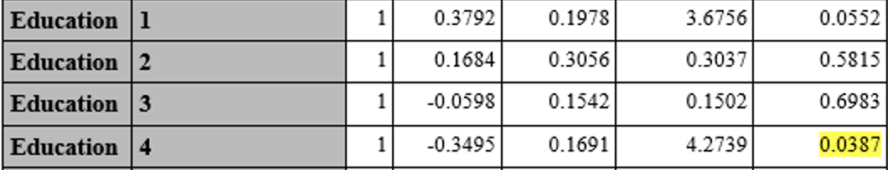
Hypothesis 5: Which demographic factors has the most influence on price sensitivity
Price_sensitivity = Age + Gender + ethnicity + Marital_status + Educational_background + location
Females are more price sensitive than male
People with Hispanic ethnic background being more price sensitive compared to people with white background.
Higher educational background show lower price sensitivity.

Slide 22
Recommendations for F&B
Introduce healthy sandwiches as premium product in outlet or premium supermarkets in major city where median income is 75K to 100K
Price sensitivity should be dependent on location the demographic is in
For example, in Philadelphia, PA the pricing should be lower compared to New York, NY though they are located nearby - the price sensitivity is different between the two states. This group is the target customer for F&G as they have a higher intention and less price sensitivity compared to other groups.
For higher income groups, F&G can afford costlier products, higher quality and more personalized branding
For low income groups where more price sensitivity exists, F&G can introduce healthy snacks that vary in price range - more weightage on taste and price rather than quality.

